Slide 1


JavaScript Objects
Siva Rallabhandi
April 27, 2017

Slide 2

Agenda
1
The this keyword
2
The new keyword
3
Object literal
4
Object.defineProperty
5
new Object()
6
Prototype
7
Object extensions
8
Class fundamentals
Notes:
Tool: http://google.github.io/traceur-compiler/demo/repl.html#

Slide 3
THIS

Slide 4
DETERMINED ON RUNTIME
Rules to determine the context of THIS
Explicit binding
Implicit binding
Hard binding
Used with new

Slide 5
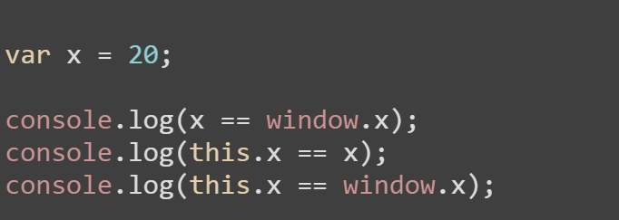
“This” in the global context
Explicit binding

Slide 6
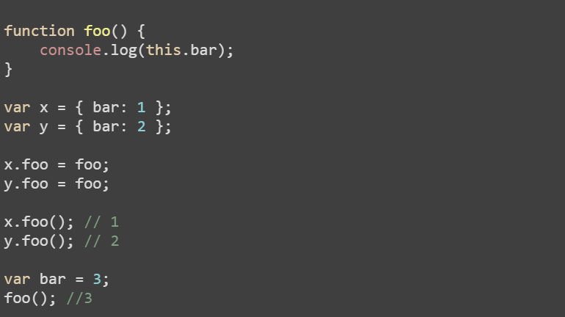
“This” in the function context
Implicit Binding: Value of this in function is determined by the form on invocation but not context of definition.

Slide 7
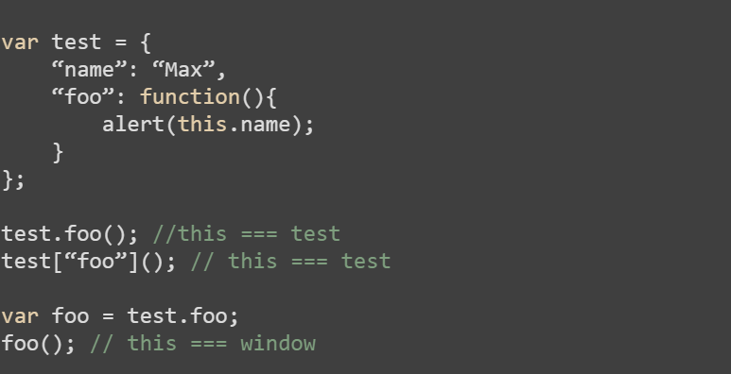
“This” in the function context
Implicit Binding

Slide 8
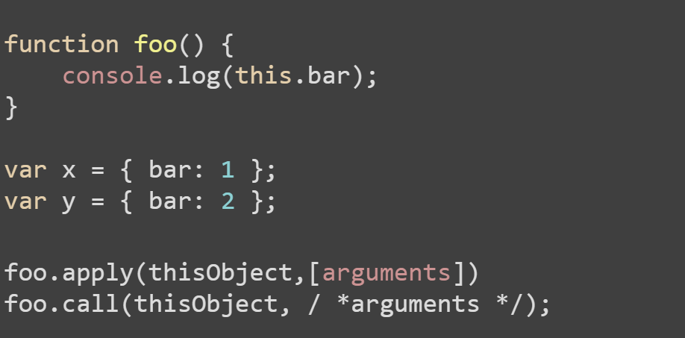
explicit setting of this
Hard binding: A function’s apply or call method allows for calling the function, explicitly specifying this.
Notes:
Re-call the example of duck typing

Slide 9
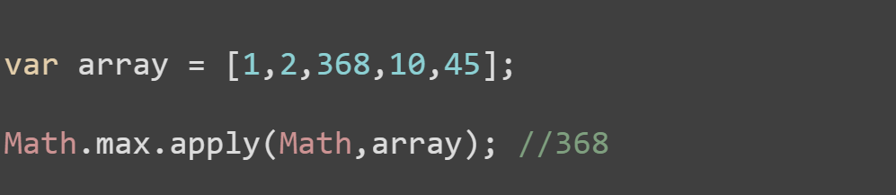
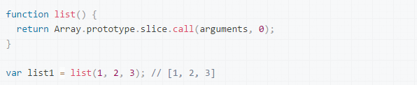
EXPLICIT SETTING OF THIS
Function borrowing

Slide 10
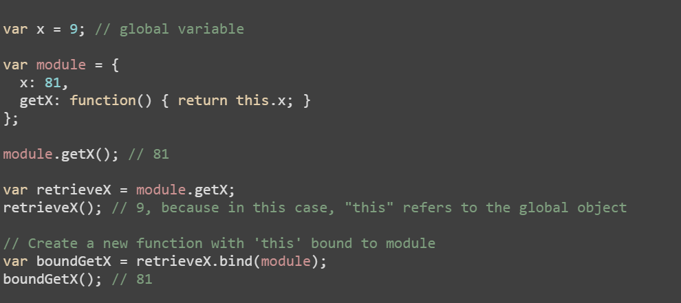
explicit setting of this
Hard binding: Can also be done using bind.

Slide 11
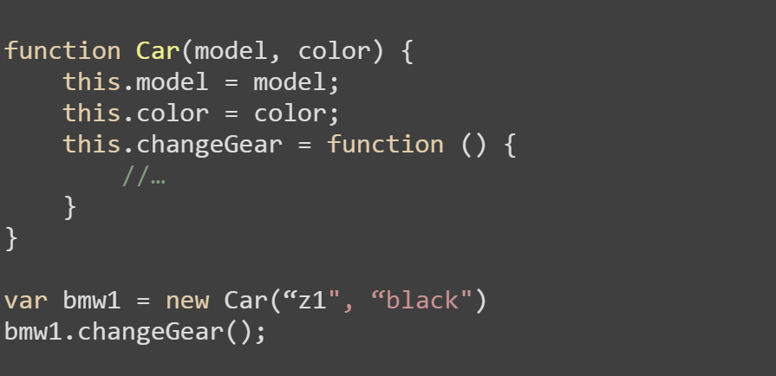
constructor form
Used with new keyword

Slide 12
The new keyword
4 important things that new keyword does:
Creates a brand new object.
Adds a [[Prototype]] link in the newly created object.
The newly created object is set as the this binding for that function call.
Will return this newly created object (unless the function returns and object of its own)

Slide 13
console.log(typeof Object);
What shows in the console?
function

Slide 14
let Task = function(action) {
this.action = action;
};
let task = new Task(“create”);
console.log(typeof task);
What shows in the console?
object

Slide 15
let Task = function(action) {
this.action = action;
return this;
};
let task = new Task(“create”);
console.log(typeof task);
What shows in the console?
object

Slide 16
let Task = function(action) {
this.action = action;
return {
done: false
};
};
let task = new Task(“create”);
console.log(task.action);
What shows in the console?
undefined

Slide 17
let Task = function(action) {
this.action = action;
return 10;
};
let task = new Task(“create”);
console.log(task.action);
What shows in the console?
create

Slide 18
let Task = function(action) {
this.action = action;
return [10];
};
let task = new Task(“create”);
console.log(task.action);
console.log(task);
What shows in the console?
undefined
[10]

Slide 19
let Task = function(action) {
this.action = action;
};
let task = new Task(“create”);
console.log(task.action);
console.log(task[“action”]);
What shows in the console?
create
create

Slide 20
let Task = function(action) {
this.action = action;
};
let task1 = new Task(“create”);
let task2 = new Task(“delete”);
console.log(task1 === task2);
What shows in the console?
false

Slide 21
Object Literal

Slide 22
let task = {};
task.action = “Create”;
task.isDone = true;
task.estHours = 16;
task.getTask = function() {
return true;
}
console.log(task.action);
What shows in the console?
Create

Slide 23
let f = “action”;
let task = {
action: “Create”,
isDone: true,
estHours: 16,
getTask: function() {
return true;
}
};
console.log(task[f]);
console.log(task.isDone);
console.log(task[“estHours”]);
What shows in the console?
Create
true
16

Slide 24
let task = {
action: “Create”,
isDone: true,
estHours: 16,
getTask: function() {
return true;
},
responsible: [“Anna”, “Boris”]
};
console.log(task.responsible[1]);
What shows in the console?
Boris

Slide 25
let task = {
action: “Create”,
isDone: true,
estHours: 16,
getTask: function() {
return true;
},
responsible: [“Anna”, “Boris”]
};
console.log(task.getAction());
What shows in the console?
TypeError: task.getAction is not a function

Slide 26
let task = {
action: “Create”,
isDone: true,
estHours: 16
};
console.log(typeof task.toString);
What shows in the console?
function

Slide 27
let project = {
tasks: [
{ action: “Create”, isDone: true },
{ action: “Delete”, isDone: false }
]
};
console.log(project.tasks[1].action);
What shows in the console?
Delete

Slide 28
let task = {
isDone: true,
estHours: 16
};
let anotherTask = task;
console.log(anotherTask.isDone);
What shows in the console?
true

Slide 29
let task = {
isDone: true,
estHours: 16
};
let anotherTask = task;
task.estHours = 8;
console.log(anotherTask.estHours);
anotherTask.estHours = 12;
console.log(task.estHours);
What shows in the console?
8
12

Slide 30
let task = {
isDone: true,
estHours: 16,
getObject: function() {
console.log(this);
}
};
console.log(task.getObject());
What shows in the console?
Object {isDone: true, estHours: 16}

Slide 31
let task = {
isDone: true,
estHours: 16,
updateEstHours: function(value) {
this.estHours = value;
let fn = function() {
console.log(this);
}
fn();
}
};
task.updateEstHours(8);
What shows in the console?
Window {…}

Slide 32
Object.defineProperty()

Slide 33
let task = { };
Object.defineProperty(task, “action”, {
value: “doIt”
});
console.log(task.action);
What shows in the console?
doIt

Slide 34
let task = { };
Object.defineProperty(task, “action”, {
value: “doIt”
});
task.action = `${task.action} now!`;
console.log(task.action);
What shows in the console?
doIt

Slide 35
“use strict”;
let task = { };
Object.defineProperty(task, “action”, {
value: “doIt”
});
task.action = `${task.action} now!`;
console.log(task.action);
What shows in the console?
TypeError: Cannot assign to read only property 'action' of object

Slide 36
let task = { };
Object.defineProperty(task, “action”, {
value: “doIt”,
writable: true
});
task.action = `${task.action} now!`;
console.log(task.action);
What shows in the console?
doIt now!

Slide 37
let task = { };
Object.defineProperty(task, “action”, {
value: “doIt”,
});
for (let field in task)
console.log(field);
What shows in the console?
<Nothing>

Slide 38
let task = { action: “doIt”
};
for (let field in task)
console.log(field);
What shows in the console?
action

Slide 39
let task = { };
Object.defineProperty(task, “action”, {
value: “doIt”,
enumerable: true
});
for (let field in task)
console.log(field);
What shows in the console?
action

Slide 40
let task = { };
Object.defineProperty(task, “action”, {
value: “doIt”
});
Object.defineProperty(task, “action”, {
value: “done”
});
console.log(task.action);
What shows in the console?
TypeError: Cannot redefine property: action

Slide 41
let task = { };
Object.defineProperty(task, “action”, {
value: “doIt”,
configurable: true
});
Object.defineProperty(task, “action”, {
value: “done”
});
console.log(task.action);
What shows in the console?
done

Slide 42
let task = {
_totalHrs: 16
};
Object.defineProperty(task, “totalHrs”, {
get: function() {
return this._totalHrs + 4;
}
});
console.log(task.totalHrs);
What shows in the console?
20

Slide 43
let task = {
_totalHrs: 16
};
Object.defineProperty(task, “totalHrs”, {
get: function() {
return this._totalHrs + 4;
},
set: function(newVal) {
this._totalHrs = newVal;
}
});
task.totalHrs = 8;
console.log(task.totalHrs);
What shows in the console?
12

Slide 44
let task = { };
Object.defineProperties(task, {
“action”: {
value: “doIt”
},
“priority”: {
value: “High”
}
});
console.log(`${task.action} – ${task.priority}`);
What shows in the console?
doIt - High

Slide 45
let task = { };
Object.defineProperties(task, {
“action”: {
value: “doIt”
}
});
let descriptor = Object.getOwnPropertyDescriptor( task, “action”);
console.log(descriptor);
What shows in the console?
Object {value: "doIt", writable: false, enumerable: false, configurable: false}

Slide 46
let task = {
action: “create”
};
console.log( task.hasOwnProperty(“action”)
);
What shows in the console?
true

Slide 47
let task = {
action: “create”
};
console.log( task.hasOwnProperty(“toString”)
);
What shows in the console?
false

Slide 48
new Object()

Slide 49
let task = new Object();
task.action = “Create”;
console.log(task.action);
What shows in the console?
Create

Slide 50
let task = new Object();
task.action = “Create”;
task.isDone = true;
task.estHours = 16;
task.getTask = function() {
return true;
}
console.log(task.getTask());
What shows in the console?
true

Slide 51
let task = new Object();
task.action = “Create”;
task.isDone = true;
task.estHours = 16;
task.getTask = function() {
return true;
}
console.log(task[“estHours”]);
What shows in the console?
16

Slide 52
let task = new Object();
task.action = “Create”;
task.isDone = true;
task.estHours = 16;
task.getTask = function() {
return true;
}
let field = “isDone”;
console.log(task[field]);
What shows in the console?
true

Slide 53
Prototype

Slide 54
Prototype
prototype is a property that gets created as soon as you define the function. Its initial value is an object with a single constructor property.
Rectangle
prototype length
Rectangle.prototype
constructor
Assert(Rectangle.prototype.constructor === Rectangle);

Slide 55
Prototype vs __proto__
The value of the prototype property is used to initialize the [[Prototype]] (or __proto__) property of a newly created object.
The [[Prototype]] property is an internal reference to prototype object.

Slide 56
function Rectangle(w, h) {
this.width = w;
this.height = h;
}
var rect1 = new Rectangle(2, 4);
Assert(rect1 instanceof Rectangle);
var rect2 = new Rectangle(8, 11);
Rectangle
prototype length
[[prototype]]
rect1
width = 2 height = 4
[[prototype]]
Rectangle.prototype
constructor
[[prototype]]
rect2
width = 8 height = 11
[[prototype]]

Slide 57
How does JavaScript locate somefunction?
let task = {…};
task.someFunction();
task.someFunction()
task.__proto__.someFunction()
task.__proto__.__proto__.someFunction()
etc.

Slide 58
console.log( typeof Object.prototype );
What shows in the console?
object

Slide 59
console.log( typeof Object.prototype.toString
);
What shows in the console?
function

Slide 60
let task = {
action: “Create”,
isDone: true
};
console.log(task.toString());
What shows in the console?
[object Object]

Slide 61
let task = {
action: “Create”,
isDone: true
};
console.log(task.prototype);
What shows in the console?
undefined

Slide 62
let task = {
isDone: false
};
let anotherTask = Object.create(task);
console.log(anotherTask.isDone);
What shows in the console?
false

Slide 63
let task = {
isDone: false
};
let anotherTask = Object.create(task);
console.log( task.isPrototypeOf(anotherTask)
);
What shows in the console?
true

Slide 64
let task = {
isDone: false
};
console.log( Object.prototype.isPrototypeOf(task)
);
What shows in the console?
true

Slide 65
let task = {
isDone: false
};
let anotherTask = Object.create(task);
console.log( Object.prototype.isPrototypeOf( anotherTask)
);
What shows in the console?
true

Slide 66
let task = {
isDone: false
};
let anotherTask = Object.create(task);
console.log(“isDone” in anotherTask);
What shows in the console?
true

Slide 67
let task = {
isDone: false
};
let anotherTask = Object.create(task);
console.log(“toString” in anotherTask);
What shows in the console?
true

Slide 68
let task = {
isDone: false
};
let anotherTask = Object.create(task);
console.log(
“isDone” in Object.prototype
);
What shows in the console?
false

Slide 69
let Task = function(action) {
this.action = action;
this.done = false;
this.complete = function() {
this.done = true;
}
};
let task = new Task(“create”);
console.log( Task.prototype.isPrototypeOf(task));
What shows in the console?
true

Slide 70
let Task = function(action) {
this.action = action;
this.done = false;
this.complete = function() {
this.done = true;
}
};
let task1 = new Task(“create”);
let task2 = new Task(“delete”);
console.log(task1.complete === task2.complete);
What shows in the console?
false

Slide 71
let Task = function(action) {
this.action = action;
this.done = false;
this.complete = function() {
this.done = true;
}
};
console.log(typeof Task.prototype);
What shows in the console?
object

Slide 72
let Task = function(action) {
this.action = action;
this.done = false;
this.complete = function() {
this.done = true;
}
};
console.log(Task.prototype
=== Object.prototype);
What shows in the console?
false

Slide 73
let Task = function(action) {
this.action = action;
this.done = false;
};
Task.prototype.complete = function() {
this.done = true;
};
let task1 = new Task(“create”);
let task2 = new Task(“delete”);
console.log(task1.complete === task2.complete);
What shows in the console?
true

Slide 74
let Task = function(action) {
this.action = action;
this.done = false;
};
console.log( typeof Task.prototype.constructor);
What shows in the console?
function

Slide 75
let Task = function(action) {
this.action = action;
this.done = false;
};
console.log( Task.prototype.constructor.name);
What shows in the console?
Task

Slide 76
let Task = function(action) {
this.action = action;
this.done = false;
};
console.log( Task.prototype.constructor === Task);
What shows in the console?
true

Slide 77
let Task = function(action) {
this.action = action;
this.done = false;
};
console.log( Task.prototype.constructor.prototype.constructor === Task);
What shows in the console?
true

Slide 78
Object Extensions

Slide 79
let task1 = {
id: 1
};
let task2 = {
priority: 100
};
Object.setPrototypeOf(task1, task2);
console.log(task1.priority);
What shows in the console?
100

Slide 80
let task1 = {
id: 1
};
let task2 = {
priority: 100
};
let target = {};
Object.assign(target, task1, task2);
console.log(target);
What shows in the console?
{id: 1, priority: 100}

Slide 81
let task1 = {
id: 1
};
let task2 = {
id: 2,
priority: 100
};
let target = {};
Object.assign(target, task1, task2);
console.log(target);
What shows in the console?
{id: 2, priority: 100}

Slide 82
let task1 = {
id: 1
};
let task2 = {
id: 2,
priority: 100
};
Object.defineProperty(task2, “hours”, {
value: 8,
enumerable: false
});
let target = {};
Object.assign(target, task1, task2);
console.log(target);
What shows in the console?
{id: 2, priority: 100}

Slide 83
let task1 = {
id: 1
};
let task2 = {
id: 2,
priority: 100
};
let task3 = {
name: “Implement…”
};
Object.setPrototypeOf(task2, task3);
let target = {};
Object.assign(target, task1, task2);
console.log(target);
What shows in the console?
{id: 2, priority: 100}

Slide 84
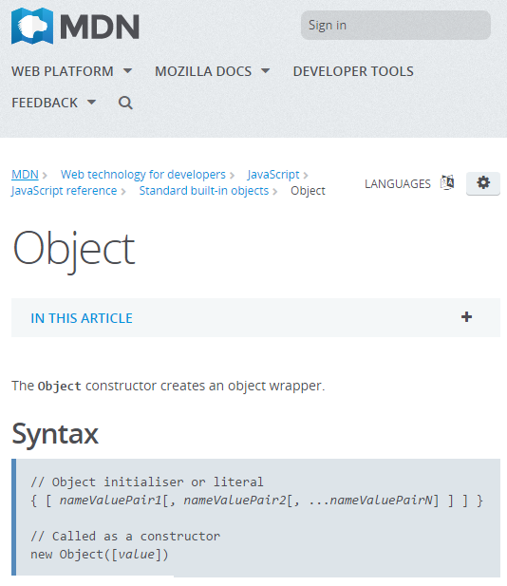
https://developer.mozilla.org/ru/docs/Web/JavaScript/Reference/ Global_Objects/Object

Slide 85
Class Fundamentals

Slide 86
class Task {
}
console.log(typeof Task);
What shows in the console?
function

Slide 87
class Task {
}
let task = new Task();
console.log(typeof task);
What shows in the console?
object

Slide 88
class Task {
}
let task = new Task();
console.log(task instanceof Task);
What shows in the console?
true

Slide 89
class Task {
showId() {
console.log(1);
}
}
let task = new Task();
task.showId();
What shows in the console?
1

Slide 90
class Task {
showId() {
console.log(1);
}
}
let task = new Task();
console.log(task.showId === Task.prototype.showId);
What shows in the console?
true

Slide 91
class Task {
let taskId = 2; // is it valid?
constructor() {
console.log(“Constructing Task”);
}
showId() {
console.log(1);
}
}
let task = new Task();
What shows in the console?
Syntax error

Slide 92
class Task {
constructor() { console.log(“Constructing Task”);
this.taskId = 2;
}
showId() {
console.log(this.taskId);
}
}
let task = new Task();
task.showId();
What shows in the console?
Constructing Task
2

Slide 93
let task = new Task();
class Task {
constructor() {
console.log(“Constructing Task”);
}
}
What shows in the console?
Error: Use before declaration

Slide 94
class Task {
}
console.log(window.Task === Task);
What shows in the console?
false

Slide 95
class Task {
constructor() {
console.log(“Constructing Task”);
}
}
class UrgentTask extends Task {
constructor() {
super();
console.log(“Urgent Task”);
}
}
let task = new UrgentTask();
What shows in the console?
Constructing Task UrgentTask

Slide 96
class Task {
constructor() {
this.id1 = 1;
}
}
class UrgentTask extends Task {
constructor() {
super();
this.id2 = 2;
}
}
let task = new UrgentTask();
console.log(task);
What shows in the console?
UrgentTask {id1: 1, id2: 2}

Slide 97
class Task {
getTaskPriority() {
return 1;
}
}
class UrgentTask extends Task {
getTaskPriority() {
return 100;
}
}
let task = new UrgentTask();
console.log(task.getTaskPriority());
What shows in the console?
100

Slide 98
class Task {
getTaskPriority() {
return 2;
}
}
class UrgentTask extends Task {
getTaskPriority() {
return super.getTaskPriority() * 100;
}
}
let task = new UrgentTask();
console.log(task.getTaskPriority());
What shows in the console?
200

Slide 99
class Task {
constructor() {
this.taskName = “Edit”;
}
}
class UrgentTask extends Task {
constructor() {
super();
this.taskName = `${this.taskName} Comment`;
}
}
let task = new UrgentTask();
console.log(task.taskName);
What shows in the console?
Edit Comment

Slide 100
class Task {
static getDefaultName() {
return “Task: unknown”;
}
}
console.log(Task.getDefaultName());
What shows in the console?
Task: unknown

Slide 101
class Task {
static let name = “Task: unknown”;
}
console.log(Task.name);
What shows in the console?
Syntax Error: ( expected

Slide 102
Q & A

Slide 103
THANK YOU
For your attention

